Slide 1

RAJIV GANDHI UNIVERSITY OF KNOWLEDGE TECHNOLOGIES-BASAR
COMPUTER SCIENCE AND ENGINEERING
TITLE : Learning Management System – Resilient Full-Stack
E-Learning Platform with Local Database Fallback
FACULTY REVIEWER
MRS. UDDAMARI NAGAMANI
(Assistant Professor)
SUBMITTED BY: Sravan Kumar Juluri (B210825)

Slide 2
INTERNSHIP DETAILS
Project Title
Learning Management System (LMS)
Organization
3Skill – India's Leading EdTech Platform
Submitted By
Sravan Kumar Juluri (B210825)
Project Reviewer
Mrs. Nagamani, Assistant Professor
Head of Department
Dr. B. Venkat Raman, Assistant Professor
Department
Computer Science and Engineering
University
Rajiv Gandhi University of Knowledge Technologies, Basar
Report Date
24 July 2026

Slide 3
INTRODUCTION
LMS
A resilient, full-stack Learning Management System connecting
instructors and students through a secure, modern e-learning interface.
This project presents a responsive, full-stack Learning Management System (LMS) designed to connect instructors and students through a secure and modern e-learning interface. Built with a Node.js and Express REST API backend and a lightweight vanilla HTML5, CSS3, and JavaScript frontend, the platform provides seamless dashboard navigation, secure authentication, course management, video rendering, and progress tracking.

Slide 4
PROBLEM STATEMENT
E-learning software implementations encounter three critical issues: cloud database vulnerability, where the server crashes if network or credentials fail; third-party media embed restrictions, where standard iframe embeds of YouTube videos trigger X-Frame-Options blocking; and inefficient progress tracking, which requires mapping student progress across courses without duplicate records. The absence of resilient, well-engineered solutions to these issues disrupts staging evaluations, breaks video playback, and reduces the reliability and usability of e-learning platforms.

Slide 5
PROPOSED SOLUTION
Secure Authentication
Course Management
Role-based login for Students and Instructors
JSON Web Tokens (JWT – secure digital login passes) with
BcryptJS (a tool that scrambles passwords) hashing
Instructors perform CRUD (Create, Read, Update, Delete)
operations on courses
Students search and view the full course catalog
Resilient Database Fallback
YouTube Embed Converter
Custom mockDB.js adapter (a backup data-storage script)
overrides Mongoose (the tool that connects to MongoDB) functions
Auto-switches to local db.json when MongoDB Atlas
(the cloud database) is unavailable
Regex (a text pattern-matching rule) utility converts
watch/short links to embeds
Bypasses X-Frame-Options (a browser security rule) blocking
for smooth playback

Slide 6
PROPOSED SOLUTION
Progress Tracking
Certificate Generation
Compound index (a database rule combining two fields)
on student & course prevents duplicate logs
Progress initializes at 10% and completes at 100%
Dynamic printable Certificate of Completion
Auto-generated once a student reaches 100% progress
Hardened RBAC (Role-Based Access
Control) Middleware
authMiddleware.js (checkpoint code) validates JWT signatures
roleMiddleware.js enforces route-level role checks

Slide 7










TECHNOLOGIES USED
NODE.JS
EXPRESS
MONGODB ATLAS
MONGOOSE
JWT
runs JavaScript on the server
framework for building the API
cloud database
connects code to MongoDB
secure login token
BCRYPTJS
HTML5
CSS3
JAVASCRIPT
JSON (db.json)
scrambles passwords safely
webpage structure
webpage styling
webpage interactivity
local backup data file

Slide 8
ARCHITECTURE
Frontend UI
HTML, CSS, JS
Express Server
server.js (REST API)
Auth & Role Middleware
authMiddleware.js / roleMiddleware.js
db.js Router
Success
connectDB() with timeout watch
Fail (5s Timeout)
MongoDB Atlas
Local db.json
Cloud DB — Success
mockDB.js Fallback — Timeout
REST API = the standard way the frontend and backend exchange data • Middleware = checkpoint code that runs before a request is handled • MongoDB Atlas = the cloud database

Slide 9
DATABASE FALLBACK LOGIC
Initialize connectDB()
Connect to MongoDB Atlas (5s Timeout)
Yes
Connected?
No
Use MongoDB Atlas
(Normal Mode)
Activate mockDB.js
Intercept Mongoose Methods
Read / Write to db.json
mockDB.js = a backup script that mimics the database when the cloud connection fails • Mongoose = the tool that normally talks to MongoDB

Slide 10
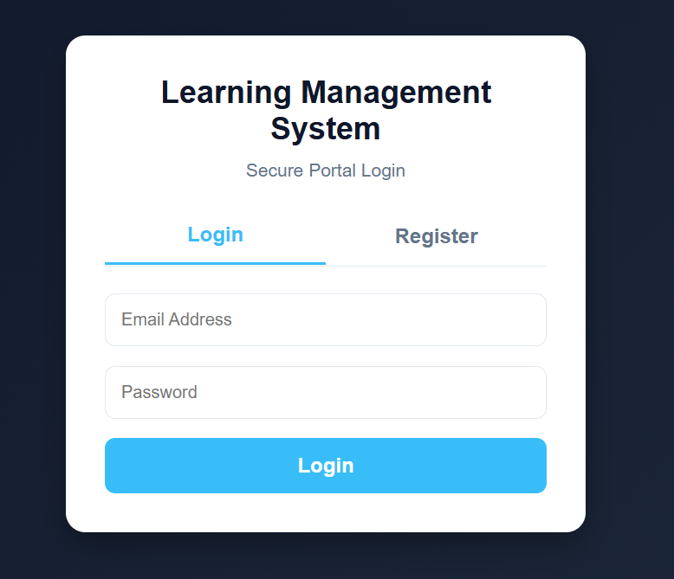
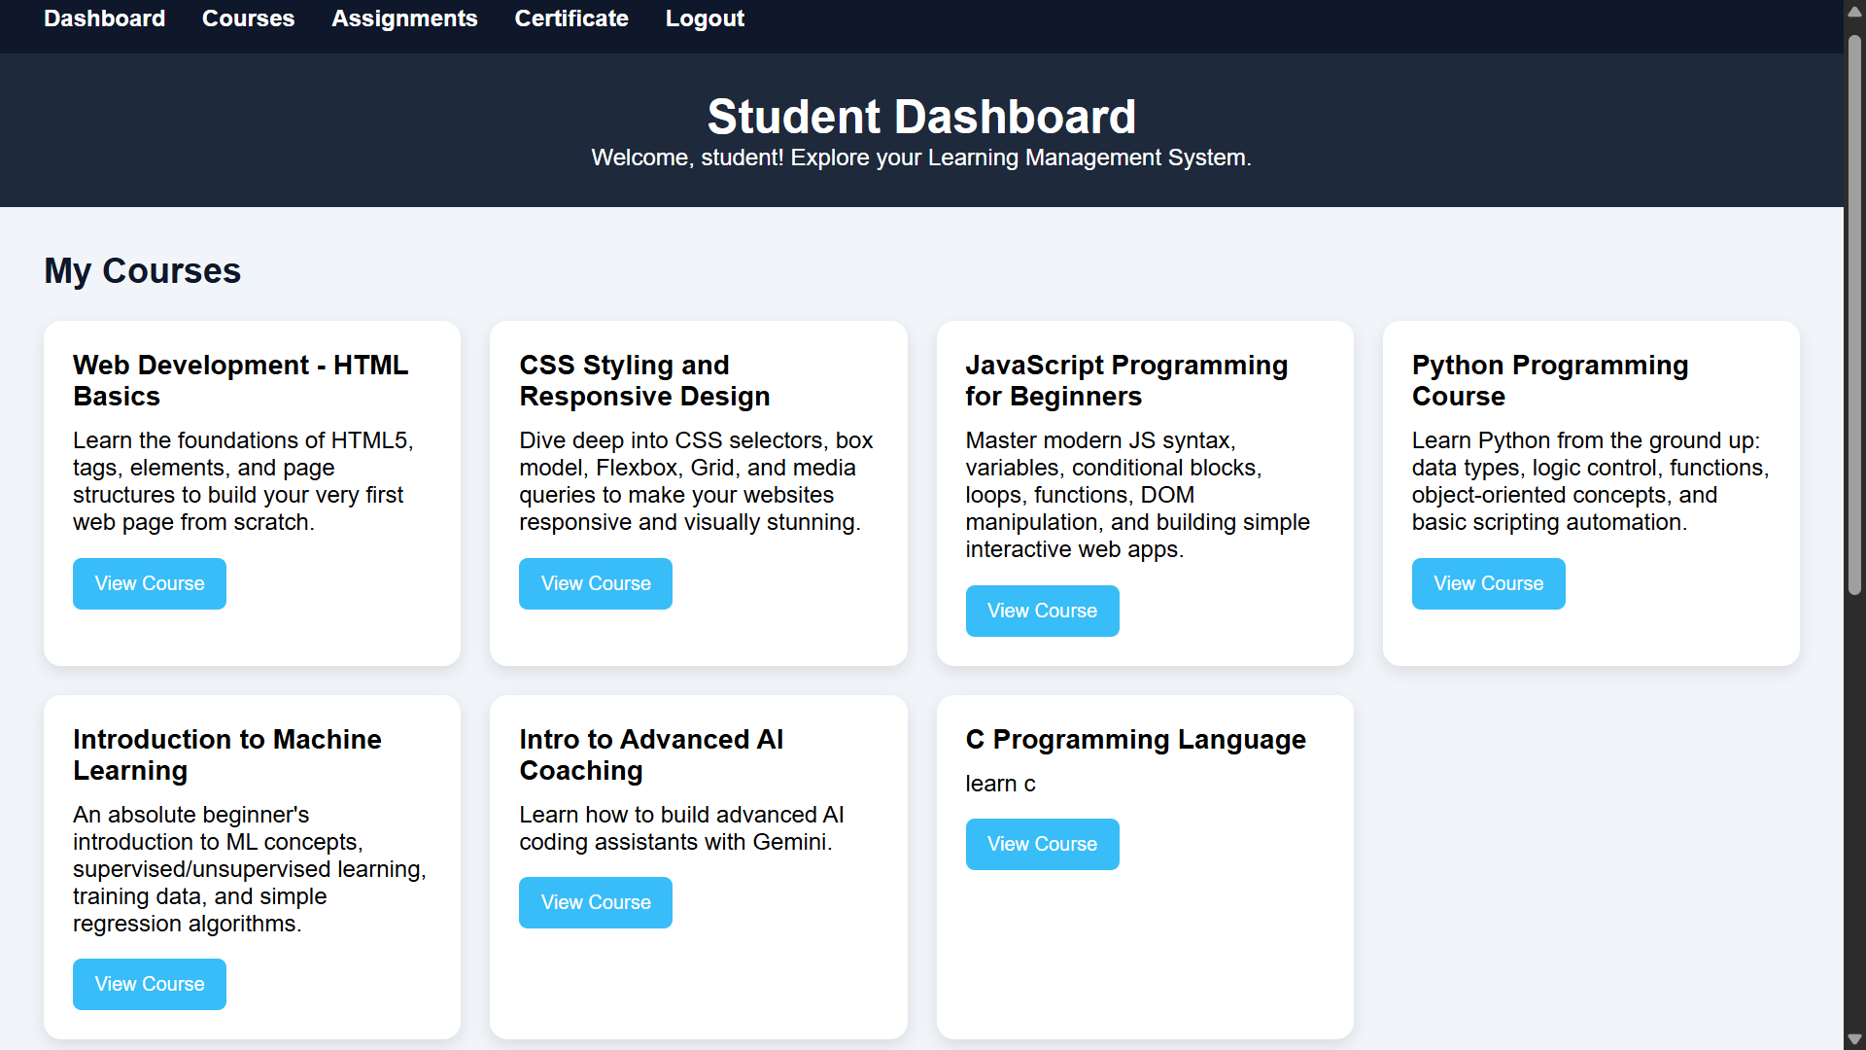
RESULTS — LOGIN & STUDENT DASHBOARD
Fig 4.1: LMS Portal Login (Role-Based)
Fig 4.2: Student Dashboard — Courses & Progress

Slide 11
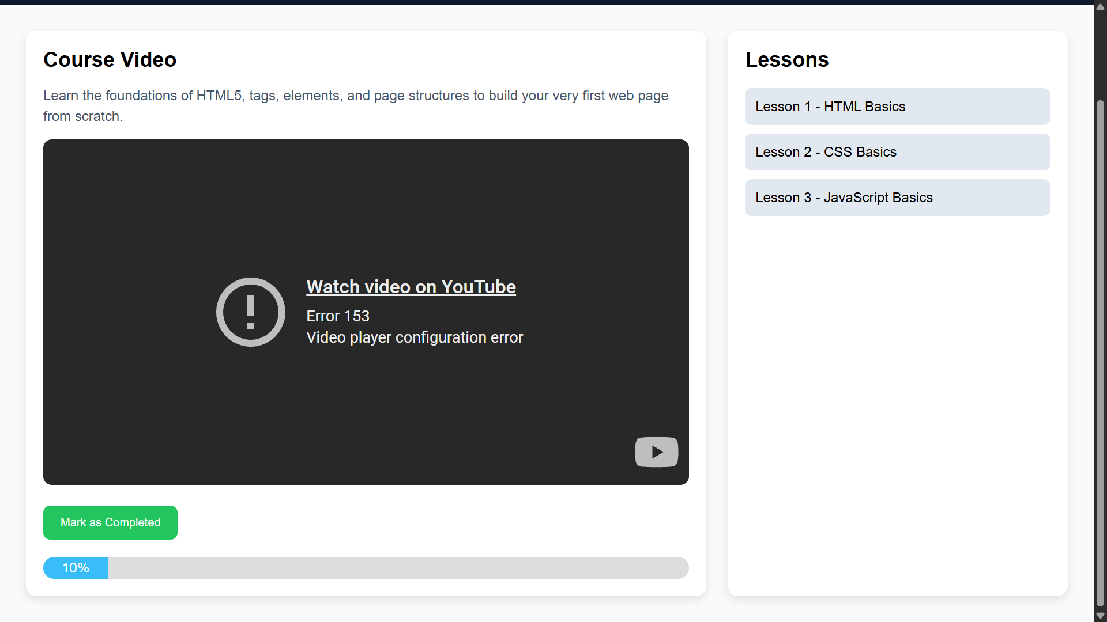
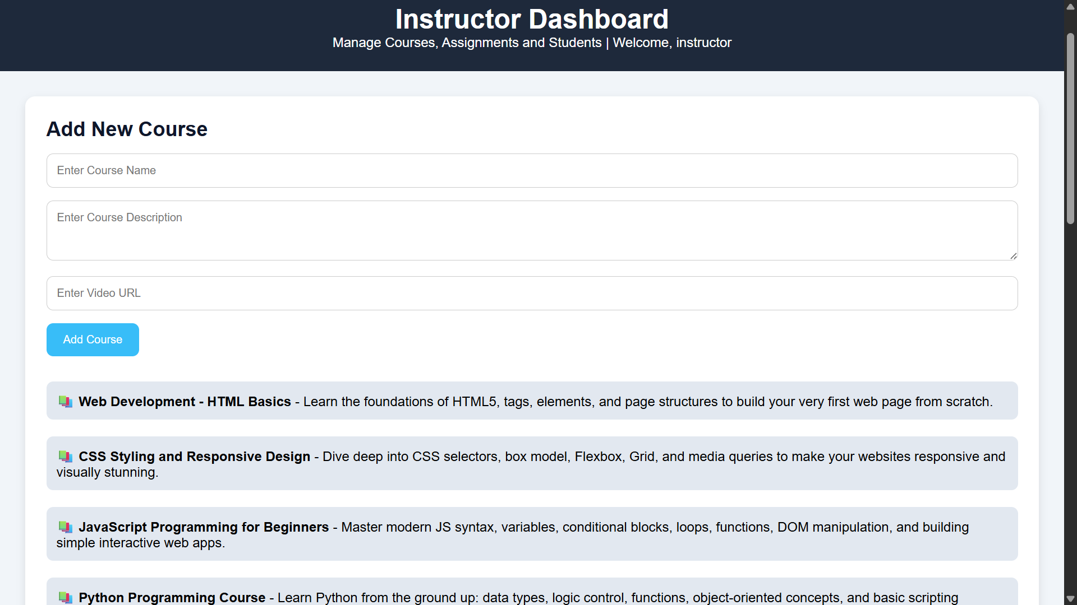
RESULTS — COURSE PLAYER & INSTRUCTOR PANEL
Fig 4.3: Course Player with Embedded Video
Fig 4.4: Instructor Dashboard — CRUD

Slide 12
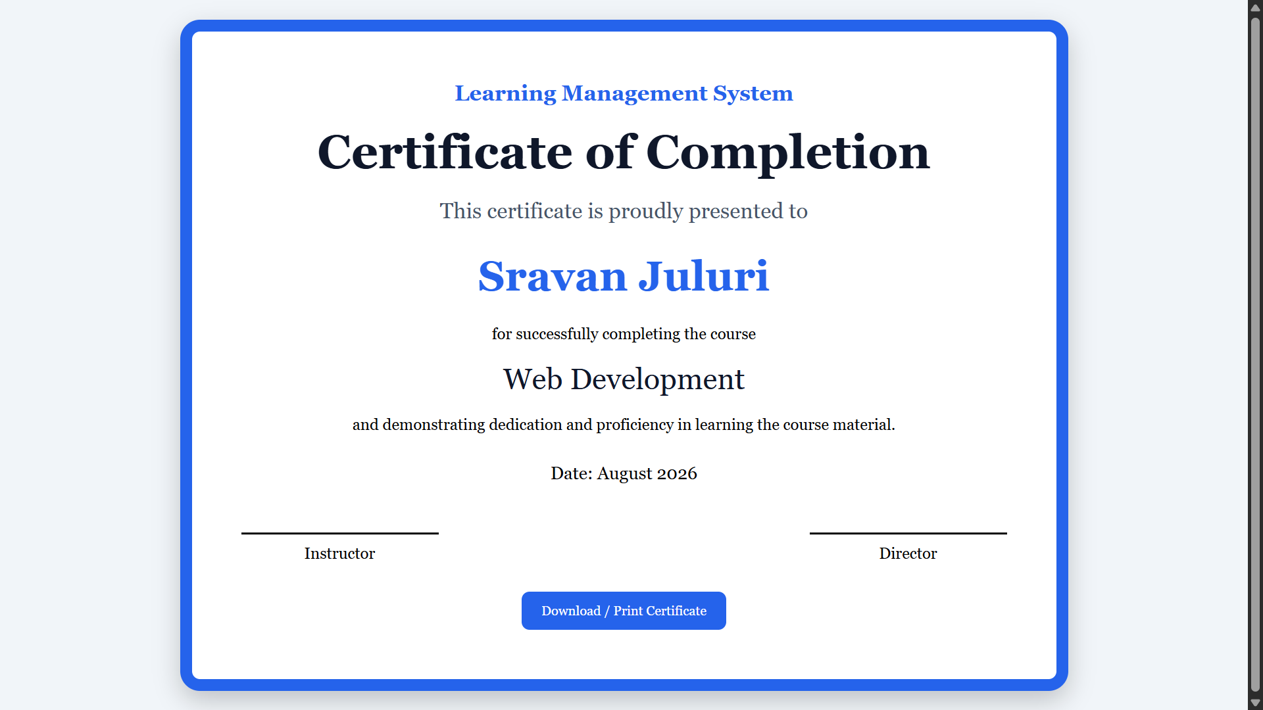
RESULTS — CERTIFICATE OF COMPLETION
Fig 4.5: Dynamically Generated, Printable Certificate

Slide 13
SOFTWARE TESTING
Test ID | Description | Result
TC02 | Login with correct credentials | Pass
TC03 | Access route without JWT (login token) | 401 Unauthorized – Pass
TC04 | Student attempts to create a course | 403 Forbidden – Pass
TC05 | MongoDB Atlas connection timeout | Falls back to db.json – Pass
TC07 | Student updates course progress | Upserted (updated or inserted), no duplication – Pass
TC08 | Standard YouTube watch URL input | Converted to embed code – Pass
TC10 | Instructor deletes another's course | 403 Forbidden – Pass
401 Unauthorized = you're not logged in • 403 Forbidden = you're logged in but not allowed to do this

Slide 14
CONCLUSION
This project successfully developed a responsive, full-stack Learning Management System that connects students and instructors through clean, functional dashboards, providing secure JWT-based authentication, catalog search, video streaming, progress tracking, and certificate generation. The primary contribution is a custom-designed database fallback adapter (mockDB.js) that maintains server operational status during cloud database downtime, preserving CRUD operations and ensuring staging availability. The project demonstrates software resilience engineering, secure role-based authentication, and dynamic media rendering, presenting a practical and robust template for offline-first web applications.

Slide 15
THANK
YOU

